Slide 1
J3-0120: Paenibacillus peoriae
H7-0687: Bacillus weihenstephanensis
μ_{max}= 0.78, N_{max} = 7.4
μ_{max}= 1.1, N_{max} = 5.8
λ = 3.5, N₀ = 3.4
λ = 6.6, N₀ = 2.1
R5-0213: Virdibacillus arenosi
W8-0169: Bacillus wiedmannii
μ_{max}= 1.3, N_{max} = 7.4
μ_{max}= 1.5, N_{max} = 6.4
λ = 3.0, N₀ = 3.1
λ = 13.4, N₀ = 2.8
Buchanan Growth parameters: Lag phase (λ, [day]), maximum growth rate (μ_{max} , [log(CFU/ml/day)]), initial cell density (N₀, [log(CFU/ml)]), and maximum cell density (N_{max}, [log(CFU/ml)])

Slide 2
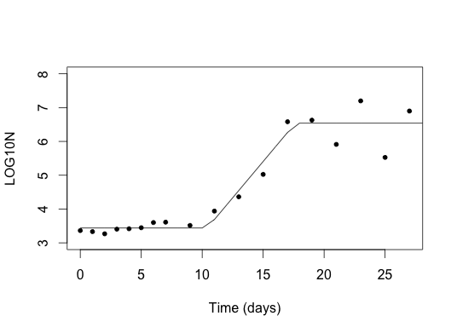
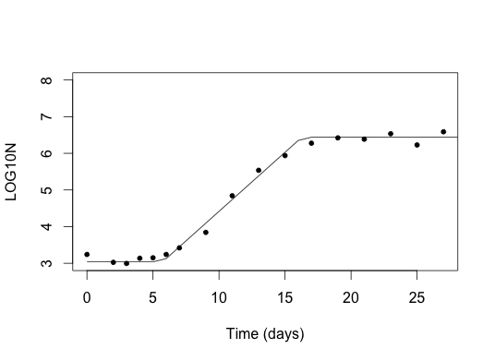
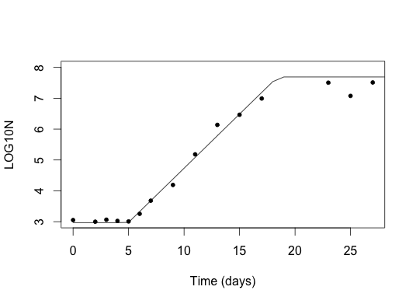
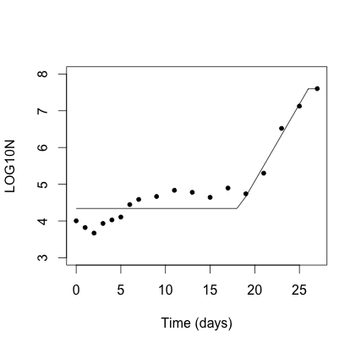
H8-0287: Paenibacillus xylanilyticus, pabuli
J3-0123: Bacillus weihenstephanensis
μ_{max}= 0.99, N_{max} = 6.5
μ_{max}= 0.74, N_{max} = 6.4
λ = 10.4, N₀ = 3.4
λ = 5.7, N₀ = 3.0
A5-0030: Paenibacillus peoriae
R7-0277: Paenibacillus sp.
μ_{max}= 0.81, N_{max} = 7.7
μ_{max}= 0.96, N_{max} = 7.6
λ = 5.0, N₀ = 3.0
λ = 18.2, N₀ = 4.3
Buchanan Growth parameters: Lag phase (λ, [day]), maximum growth rate (μ_{max} , [log(CFU/ml/day)]), initial cell density (N₀, [log(CFU/ml)]), and maximum cell density (N_{max}, [log(CFU/ml)])

Slide 3
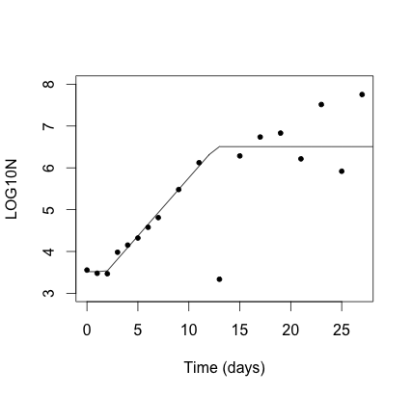
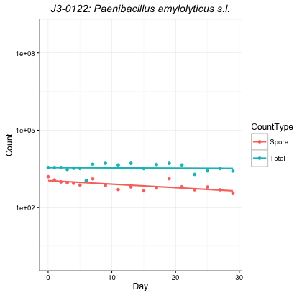
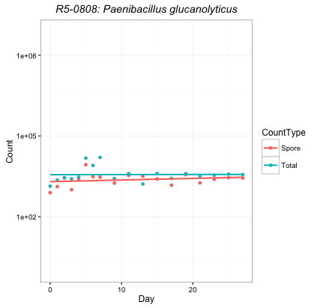
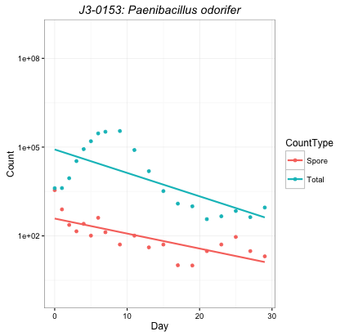
H8-0237: Paenibacillus odorifer
μ_{max}= 0.64, N_{max} = 6.5
λ = 1.9, N₀ = 3.5
Buchanan Growth parameters: Lag phase (λ, [day]), maximum growth rate (μ_{max} , [log(CFU/ml/day)]), initial cell density (N₀, [log(CFU/ml)]), and maximum cell density (N_{max}, [log(CFU/ml)])

